Slide 1
Using bacteria for Drug Delivery
Katherine Kalacheva

Slide 2
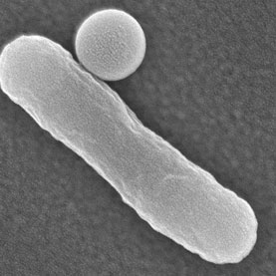
Rod-shaped E. coli bacterium, with attached particle

Slide 3
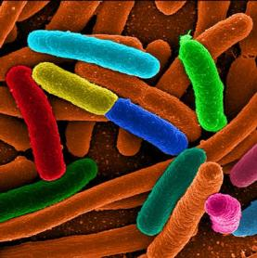
Some scientists think they can coax bacteria to deliver nanoparticles and drugs into living human cells.

Slide 4
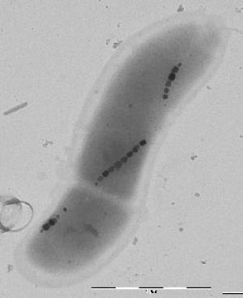
Strings of magnetic nanoparticles within bacteria.

Slide 10
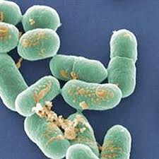
L. Monocytogene

Slide 12
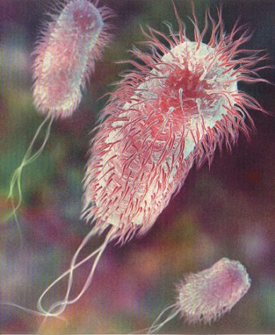
E-Coli Bacterium

Slide 14
Thank you!

